Slide 1
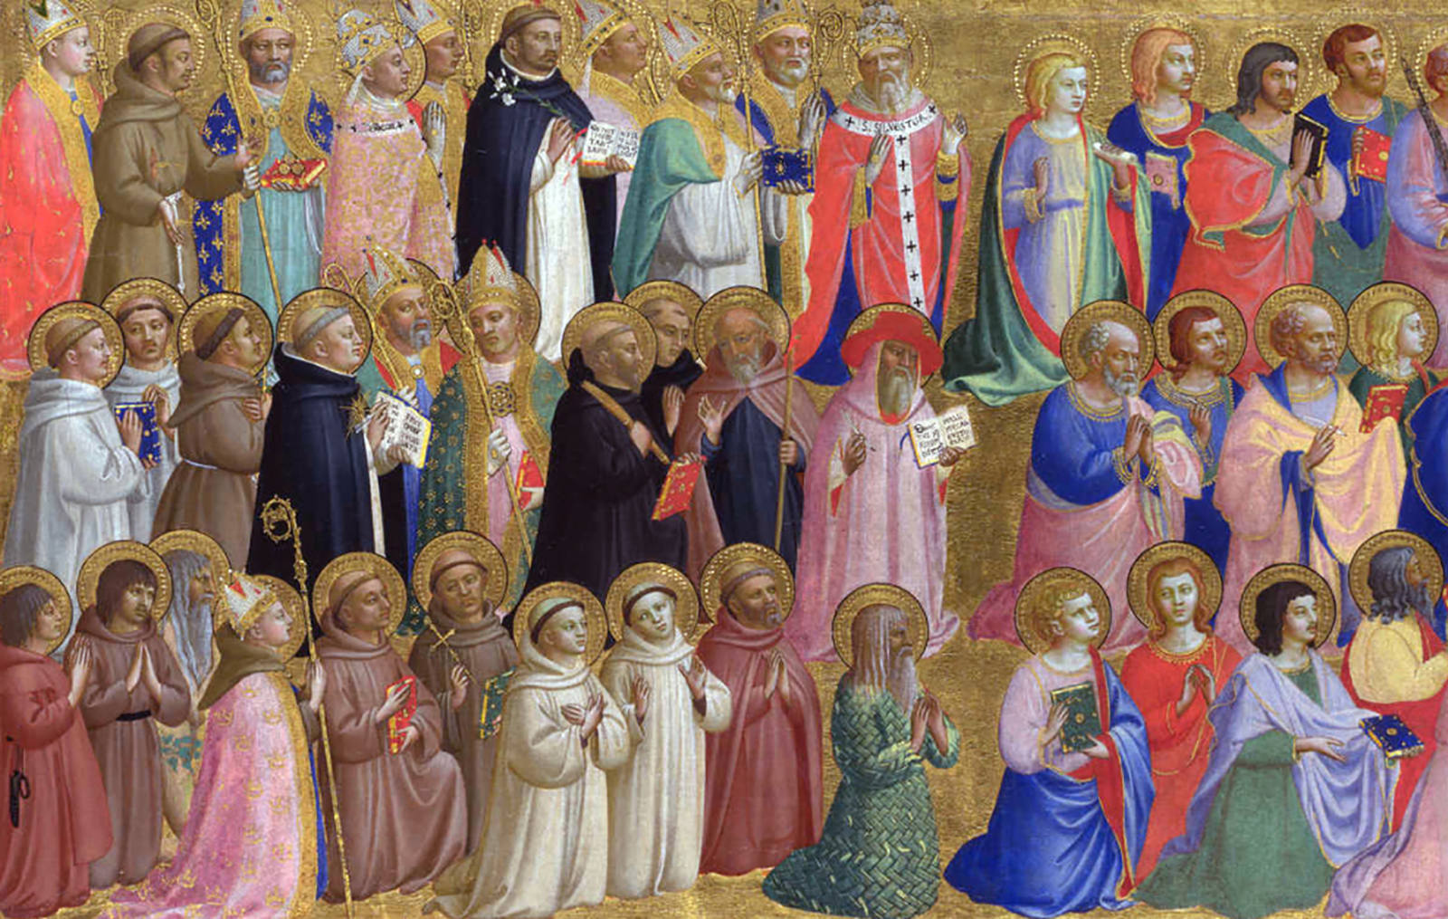
Litany of the Saints
Praying for a New Pope

Slide 2
Cantor: E te Ariki, All: Lord, have mercy.
Cantor: E te Karaiti, All: Christ, have mercy.
Cantor: E te Ariki, All: Lord, have mercy.

Slide 3
Cantor: Holy Mary, Mother of God All: īnoi mō mātou.
Cantor: Mother of the Church All: īnoi mō mātou.
Cantor: Queen of Apostles All: īnoi mō mātou.
Cantor: Queen of Peace All: īnoi mō mātou.

Slide 4
Cantor: Saint Michael the Archangel All: īnoi mō mātou.
Cantor: Saint Gabriel All: īnoi mō mātou.
Cantor: Saint Raphael All: īnoi mō mātou.
Cantor: Holy Angels of God All: īnoi mō mātou.

Slide 5
Cantor: Saint Joseph All: īnoi mō mātou.
Cantor: Saint John the Baptist All: īnoi mō mātou.
Cantor: Saint Mary Magdalene All: īnoi mō mātou.
Cantor: All disciples of the Lord All: īnoi mō mātou.

Slide 6
All: All you holy men and women pray for us.

Slide 7
Cantor: Saints Peter and Paul All: pray for us.
Cantor: Saint Andrew All: pray for us.
Cantor: Saints John and James All: pray for us.
Cantor: Saint Thomas All: pray for us.

Slide 8
Cantor: Saint Matthew All: pray for us.
Cantor: Saint Mark All: pray for us.
Cantor: Saint Luke All: pray for us.
Cantor: All Apostles and Evangelists All: pray for us.

Slide 9
All: All you holy men and women pray for us.

Slide 10
Cantor: Saint Stephen All: ora pro nobis.
Cantor: Saints Perpetua and Felicity All: orate pro nobis.
Cantor: Saint Peter Chanel All: ora pro nobis.
Cantor: All Martyrs of the Church All: orate pro nobis.

Slide 11
Cantor: Saint John XXIII All: ora pro nobis.
Cantor: Saint Paul VI All: ora pro nobis.
Cantor: Saint John Paul II All: ora pro nobis.
Cantor: All Popes of the Church All: orate pro nobis.

Slide 12
All: All you holy men and women pray for us.

Slide 13
Cantor: Saints Augustine and Benedict All: īnoi mō mātou.
Cantor: Saint Patrick All: īnoi mō mātou.
Cantor: Saints Francis and Clare All: īnoi mō mātou.
Cantor: Saint Dominic
All: īnoi mō mātou.

Slide 14
Cantor: Saint Ignatius of Loyola All: īnoi mō mātou.
Cantor: Saint Teresa of Avila All: īnoi mō mātou.
Cantor: Saint John Vianney All: īnoi mō mātou.
Cantor: Saint Damian of Molokai
All: īnoi mō mātou.

Slide 15
All: All you holy men and women pray for us.

Slide 16
Cantor: Saint Marcellin Champagnat All: pray for us.
Cantor: Saint Jeanne Jugan All: pray for us.
Cantor: Venerable Suzanne Aubert All: pray for us.
Cantor: Venerable Catherine McAuley All: pray for us.

Slide 17
Cantor: Saint Mary MacKillop All: pray for us.
Cantor: Saint Teresa of Kolkata All: pray for us.
Cantor: All holy men and women All: pray for us.
Cantor: Saints of God All: pray for us.

Slide 18
All: All you holy men and women pray for us.

Slide 19
Cantor: For the Church All: whakarongo mai ki ta matou īnoi.
Cantor: For wisdom and for insight All: whakarongo mai ki ta matou īnoi.
Cantor: For those in courage and compassion All: whakarongo mai ki ta matou īnoi.
Cantor: For those in Conclave
All: whakarongo mai ki ta matou īnoi.

Slide 20
Cantor: Christ, hear us All: Christ, graciously hear us.

